Slide 1


MTN.*NIX.11
Automated Environment
Configuration Management
Ansible
Exam
Siarhei Beliakou
email: siarhei_beliakou@epam.com
2017

Slide 2


You should be able to create a delivery pipeline
playbook:
createvm.yml
playbook:
provisionvm.yml
playbook:
deploy.yml
playbook:
application_tests.yml
git.epam.com
All steps details can be found in Jenkinsfile

Slide 3
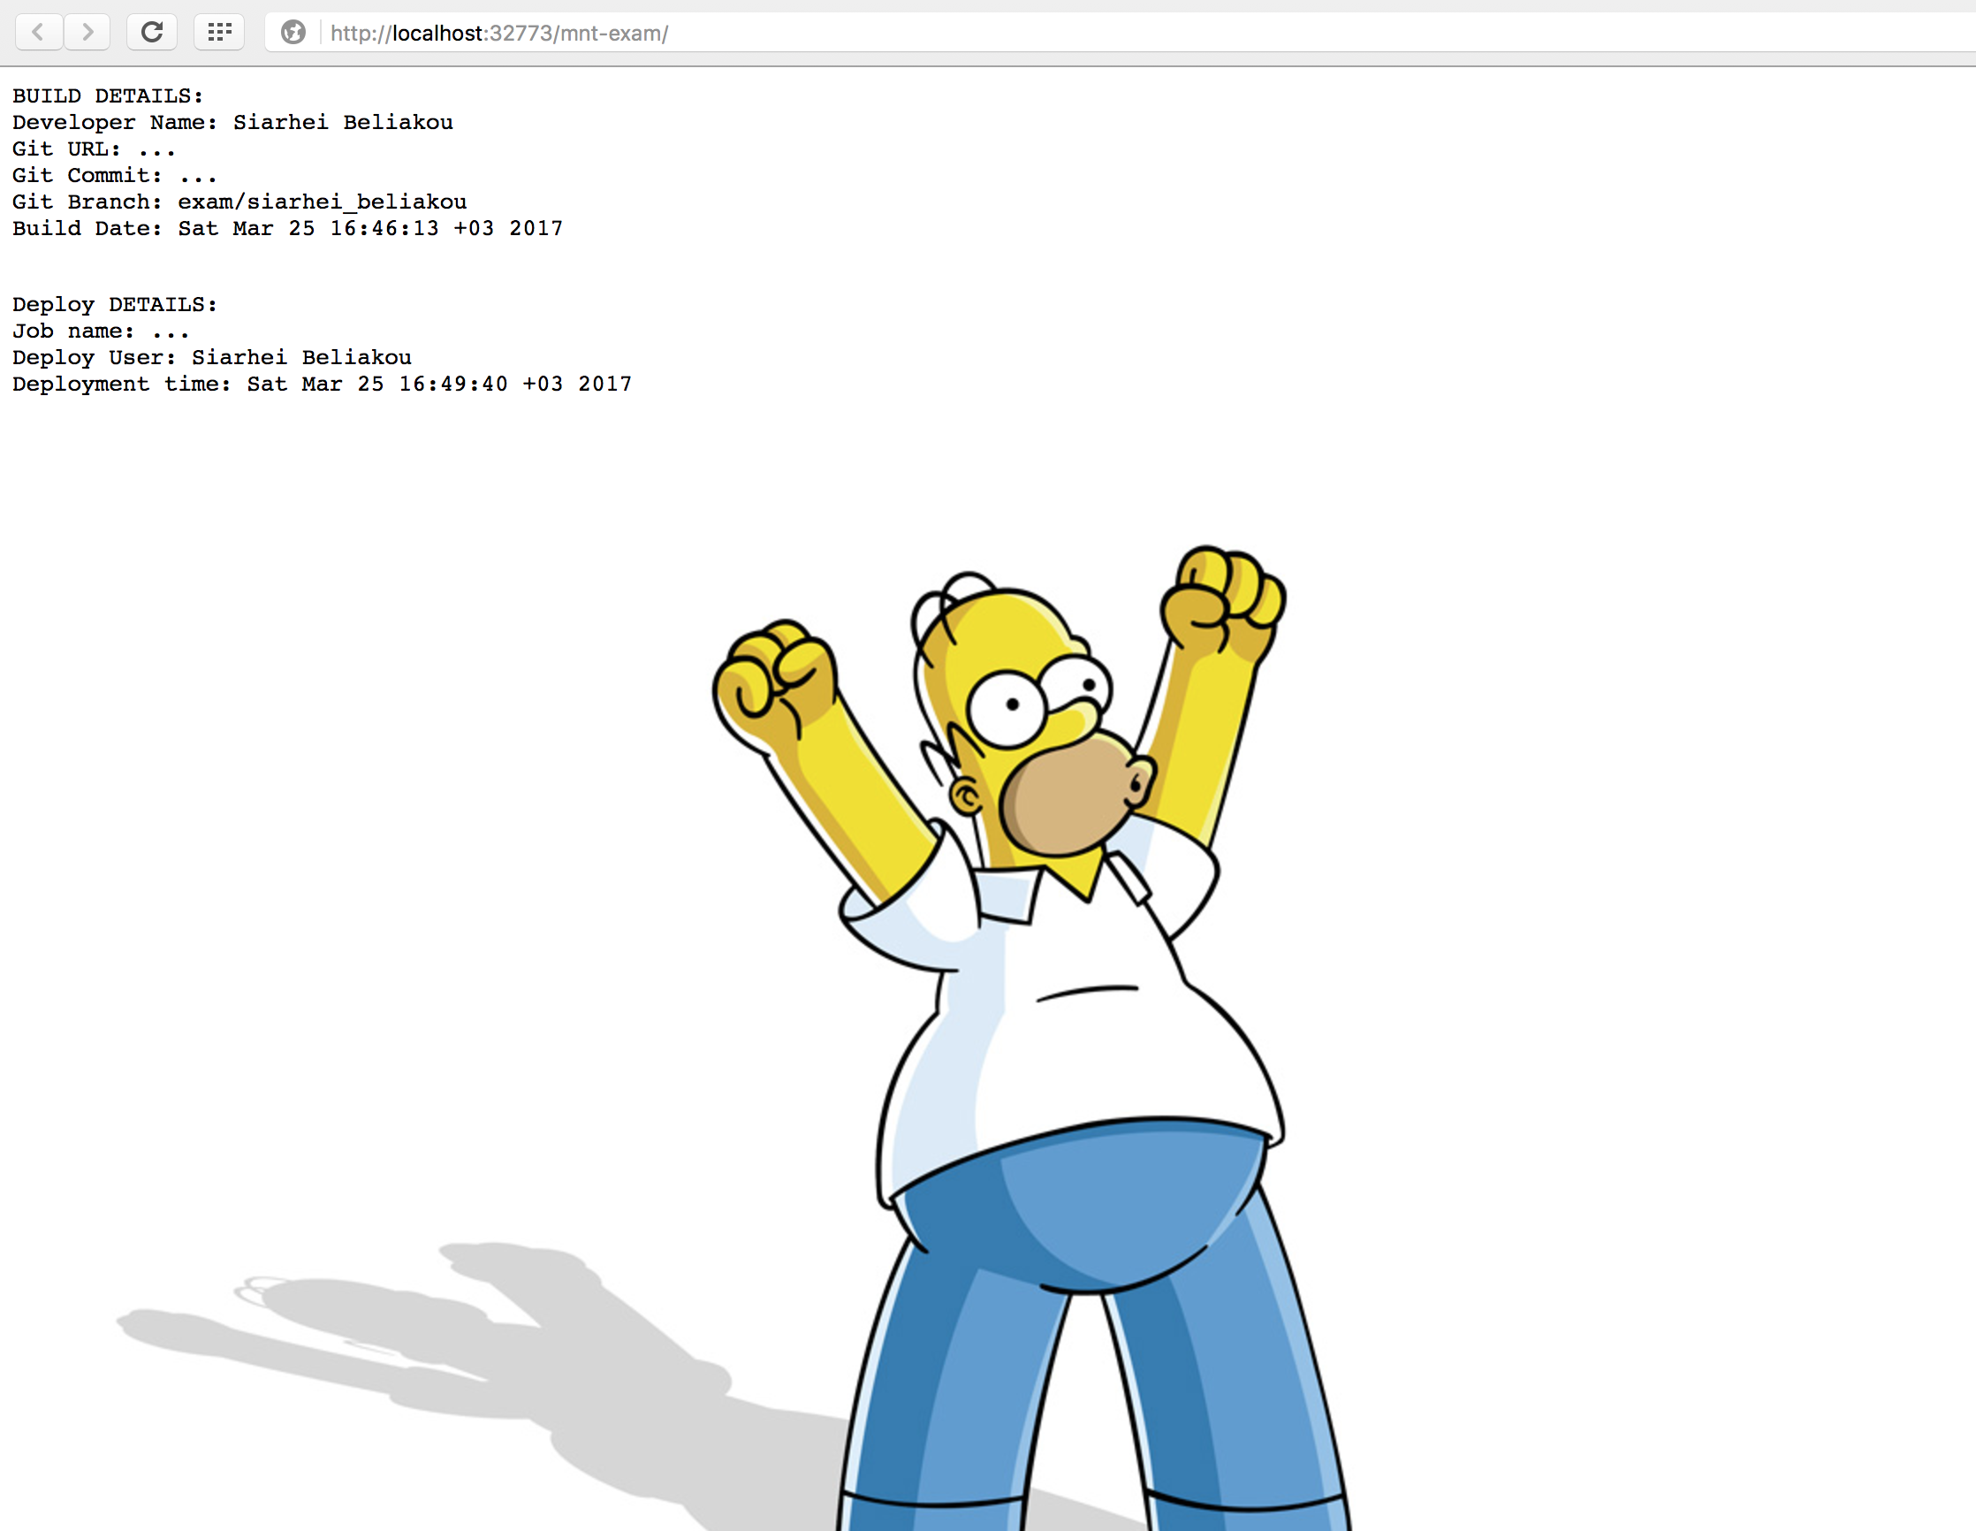

Slide 4

Enough for today ☺
QUESTIONS?
MTN.*NIX.11
Automated Environment Configuration Management

